Slide 1
Working Capital Management
組員：
108AB8003 林茵婷
108AB8006 林玟妤
108AB8009 王昱媜
108AB8028 趙薇喻

Slide 2


Overview of Working Capital
26.1
The Cash Cycle
Firm Value and Working Capital

Slide 3
26.1 Overview of Working Capital
The main components of net working capital are cash, inventory, receivables, and payables
Working capital includes the cash that is needed to run the firm on a day-to-day basis. It does not include excess cash, which is cash that is not required to run the business and can be invested at a market rate.
Chapter 14, Excess cash may be viewed as part of the firm’s capital structure, offsetting firm debt
Chapter 8, How any increases in net working capital represent an investment that reduces the cash that is available to the firm
Therefore, working capital alters a firm’s value by affecting its free cash flow

Slide 4
The Cash Cycle
The level of working capital reflects the length of time between when cash goes out of a firm at the beginning of the production process and when it comes back in.
A firm typically buys its inventory on credit, which means that the firm does not have to pay cash immediately at the time of purchase.
After receiving the inventory, even if the inventory is in the form of finished goods, it may sit on the shelf for some time.
Finally, when the inventory is ultimately sold, the firm may extend credit to its customers, delaying when it will receive the cash.
Notes:
營運資金的水平反映了從生產過程開始時現金流出公司到現金返還之間的時間長度
公司通常以信用貸款方式購買庫存，這表示公司不用在購買時立即支付現金。
收到庫存後，即使庫存為製成品形式，也可能在貨架上放置一段時間
最後，當最終出售存貨時，公司可以向其客戶提供信貸，進而延遲了公司收到現金的時間

Slide 5
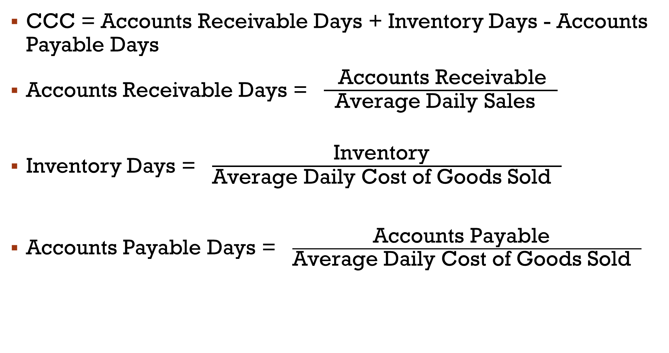
Cash Conversion Cycle (CCC)
CCC = Accounts Receivable Days + Inventory Days - Accounts Payable Days
Accounts Receivable Days = $\frac{ \text{Accounts} \text{Receivable} }{\text{Average} \text{Daily} \text{Sales} }$
Inventory Days = $\frac{\text{Inventory} }{\text{Average} \text{Daily} \text{Cost} \text{of} \text{Goods} \text{Sold} }$
Accounts Payable Days = $\frac{\text{Accounts} \text{Payable} }{\text{Average} \text{Daily} \text{Cost} \text{of} \text{Goods} \text{Sold} }$
Notes:
CCC(現金循環週期) =應收帳款週轉天數 + 存貨週轉天數 – 應付帳款週轉天數
應收帳款週轉天數 = 應收帳款 ÷ 每日平均銷貨收入
存貨週轉天數 =存貨 ÷ 每日平均銷貨成本
應付帳款週轉天數 = 應付帳款 ÷每日平均銷貨成本

Slide 6
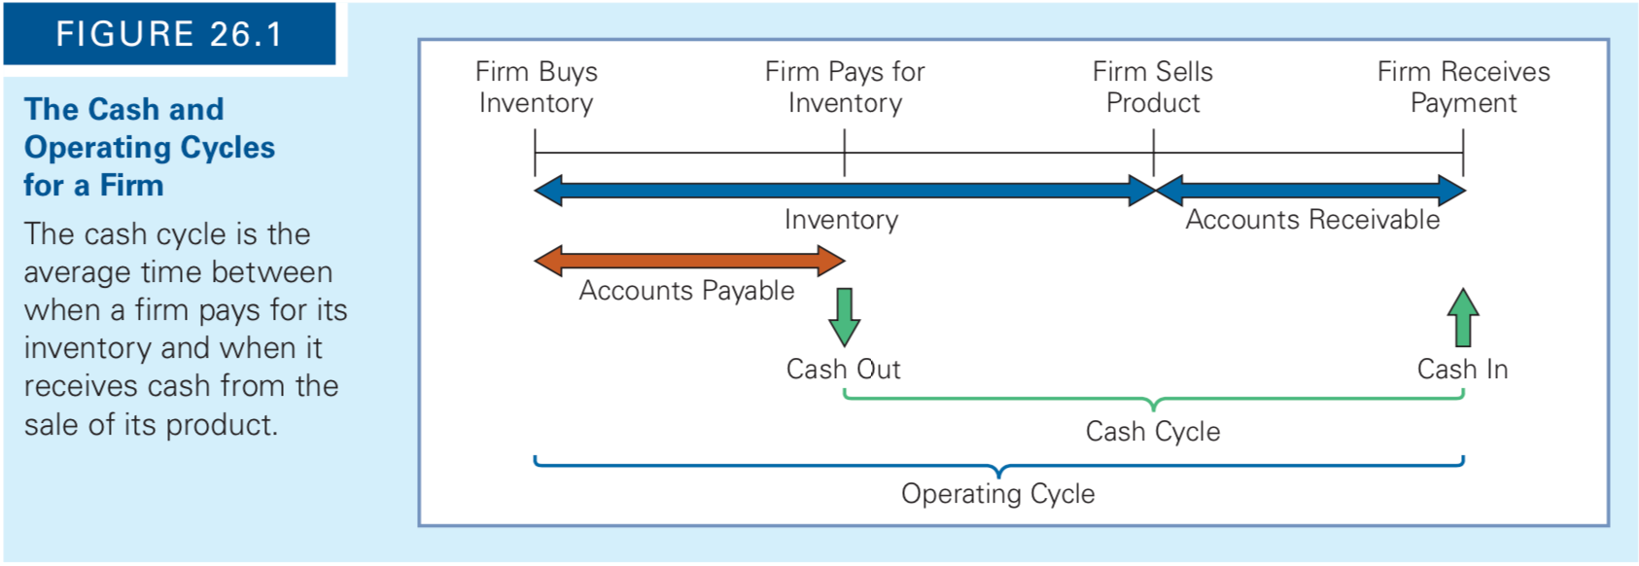
Cash Conversion Cycle (CCC)
The cash cycle is the average time between when a firm pays for its inventory and when it receives cash from the sale of its product.
Notes:
現金循環週期是公司支付存貨貨款到銷售產品後收到現金的平均時間。

Slide 7
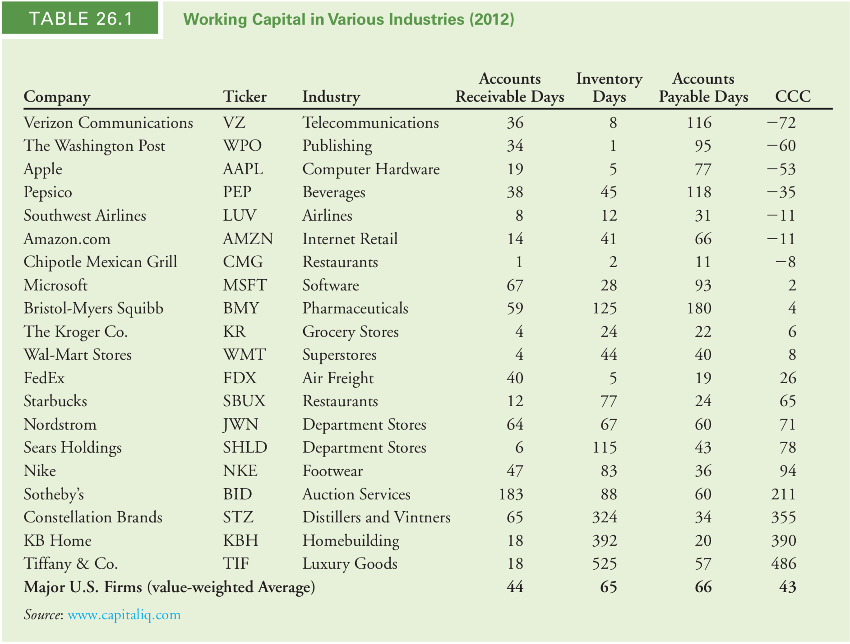
Cash Conversion Cycle (CCC)

Slide 8
Firm Value and Working Capital
Any reduction in working capital requirements generates a positive free cash flow that the firm can distribute immediately to shareholders. For example, if a firm is able to reduce its required net working capital by $50,000 permanently, it will be able to distribute this $50,000 as a dividend to its shareholders immediately and thus increase firm value by the same amount. Similarly, when evaluating a project, reducing the project’s net working capital needs over the project’s life reduces the opportunity cost associated with this use of capital.
Notes:
自由現金流量是公司在不影響營運下可以自由使用的現金餘額，也是衡量公司財務彈性的指標。
營運資金需求任何的減少都會產生正的自由現金流，公司可以立即將其分配給股東。 例如，如果一家公司能夠將其所需的淨營運資金永久減少50,000美元，
那麼它將能夠立即將這50,000美元作為股利分配給其股東，從而使公司價值增加相同的數額。
同樣，在評估項目時，減少項目在整個生命週期內的淨營運資金需求，也會減少與使用資金相關的機會成本。

Slide 9
Example 26.1 Costly Working Capital for a Project
Problem：Emerald City Paints would like to construct a new facility that will manufacture paint. In addition to the capital expenditure on the plant, management estimates that the project will require an investment today of $450,000 for net working capital. The firm will recover the investment in net working capital eight years from today, when management anticipates closing the plant. The discount rate for this type of cash flow is 6% per year. What is the present value of the cost of working capital for the paint facility? What is the value of an inventory policy that would halve the plant’s net working capital requirements?

Slide 10
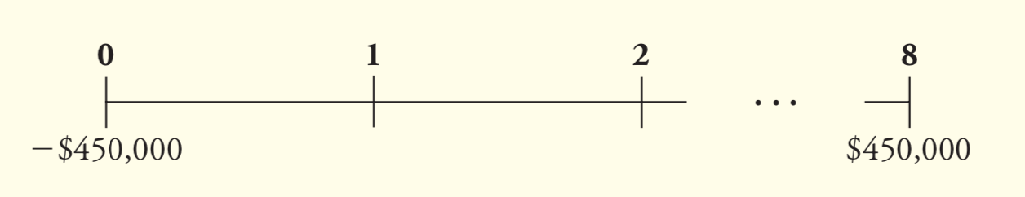
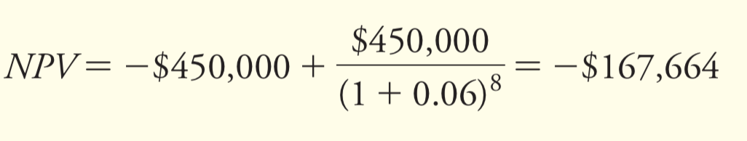
Example 26.1 Costly Working Capital for a Project
Solution：The cash flows for the investment in net working capital are -$450,000 today and +$450,000 eight years from today. Putting this on a timeline:
Given a discount rate of 6% per year, the NPV of these cash flows is

Slide 11
Example 26.1 Costly Working Capital for a Project
Although Emerald City Paints receives back all of its investment in working capital, it loses the time value of money on this cash. If a new inventory policy could halve this requirement, it would be worth $167,664/2 = $83,832 to the firm.
Managing working capital efficiently will maximize firm value.

Slide 12
26.2
Trade Credit
Trade Credit Terms
Trade Credit and Market Frictions
Managing Float

Slide 13
26.2 Trade Credit
When a firm allows a customer to pay for goods at some date later than the date of purchase, it creates an account receivable for the firm and an account payable for the customer.
Accounts receivable represent the credit sales for which a firm has yet to receive payment. The accounts payable balance represents the amount that a firm owes its suppliers for goods that it has received but for which it has not yet paid. The credit that the firm is extending to its customer is known as trade credit.
Notes:
當公司允許客戶在購買之日後的某個日期付款時，這個款項將分別成為該公司的應收帳款和該客戶的應付帳款。
應收帳款代表企業尚未收到款項的信貸銷售，
應付帳款餘額代表公司欠其供應商的已收貨但尚未支付的貨款。
而公司向客戶提供的信用稱為貿易信用。

Slide 14
Trade Credit
If a supplier offers its customers terms of “Net 30,” payment is not due until 30 days from the date of the invoice.
Sometimes the selling firm will offer the buying firm a discount if payment is made early.
The terms “2/10, Net 30” mean that the buying firm will receive a 2% discount if it pays for the goods within 10 days; otherwise, the full amount is due in 30 days.
Notes:
如果供應商向其客戶提供“Net 30”條款，則應在發票日期後的30天之內付款。
有時候，如果提早付款，則賣方會為買方提供折扣。
“ 2/10, Net 30 ” 表示買方如果在10天內付款，則將獲得2％的折扣； 否則，應在30天內支付全額

Slide 15
Trade Credit and Market Frictions
In a perfectly competitive market, trade credit is just another form of financing. Under the Modigliani-Miller assumptions of perfect capital markets, the amounts of payables and receivables are therefore irrelevant. In reality, product markets are rarely perfectly competitive, so firms can maximize their value by using their trade credit options effectively.
Notes:
在完全競爭的市場中，貿易信貸只是另一種融資形式。 因此，在MM假設資本市場完美的情況下，應付帳款和應收帳款的金額無關緊要。 實際上，產品市場很少具有完全競爭性，因此公司可以通過有效使用貿易信貸的選擇來最大化其價值。

Slide 16
Cost of Trade Credit
Suppose a firm sells a product for $100 but offers its customer terms of 2/10, Net 30. The customer doesn’t have to pay anything for the first 10 days, so it effectively has a zero-interest loan for this period. If the customer takes advantage of the discount and pays within the 10-day discount period, the customer pays only $98 for the product. The cost of the discount to the selling firm is equal to the discount percentage times the selling price. In this case, it is 0.02 * $100, or $2.
Notes:
假設某公司以100美元的價格出售產品，但提供的客戶條件為2/10，Net 30。
客戶在前10天無需支付任何費用，因此在此期間實際上擁有零利率貸款。如果客戶利用折扣並在10天的折扣期內付款，則客戶只需為該產品支付$ 98。
銷售公司的給的折扣成本等於折扣百分比乘以售價。在這種情況下，它是0.02 * $ 100，即$ 2。
客戶不必在10天內付款，而是可以選擇在其他20天內使用這 $ 98 (30-10=20)。貸款20天的利率為$ 2 / $ 98 = 2.04％。一年365天，超過20天的年費率相當於

Slide 17
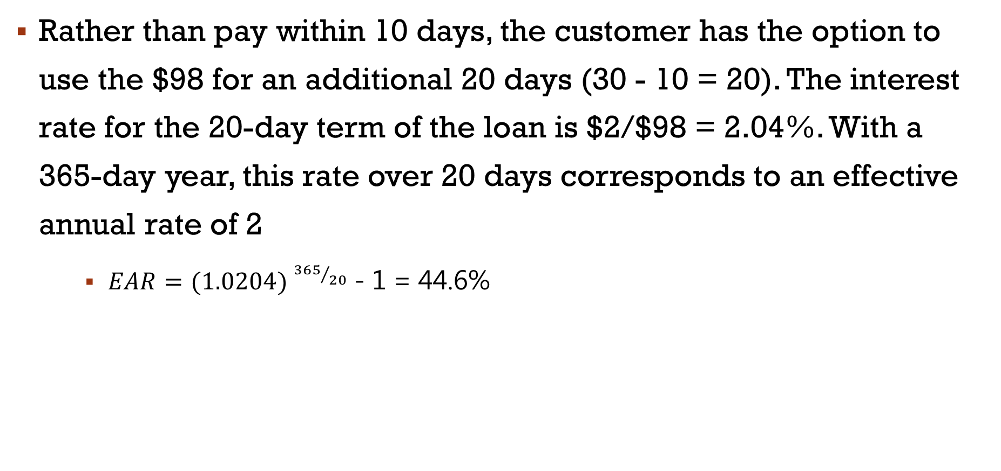
Cost of Trade Credit
Rather than pay within 10 days, the customer has the option to use the $98 for an additional 20 days (30 - 10 = 20). The interest rate for the 20-day term of the loan is $2/$98 = 2.04%. With a 365-day year, this rate over 20 days corresponds to an effective annual rate of 2
$EAR={(1.0204) }^{{365}/{20}}$ - 1 = 44.6%
Notes:
客戶不必在10天內付款，而是可以選擇在其他20天內使用這 $ 98 (30-10=20)。貸款20天的利率為$ 2 / $ 98 = 2.04％。一年365天，超過20天的年費率相當於

Slide 18
Cost of Trade Credit
Thus, by not taking the discount, the firm is effectively paying 2.04% to borrow the money for 20 days, which translates to an effective annual rate of 44.6%! If the firm can obtain a bank loan at a lower interest rate, it would be better off borrowing at the lower rate and using the cash proceeds of the loan to take advantage of the discount offered by the supplier.

Slide 19
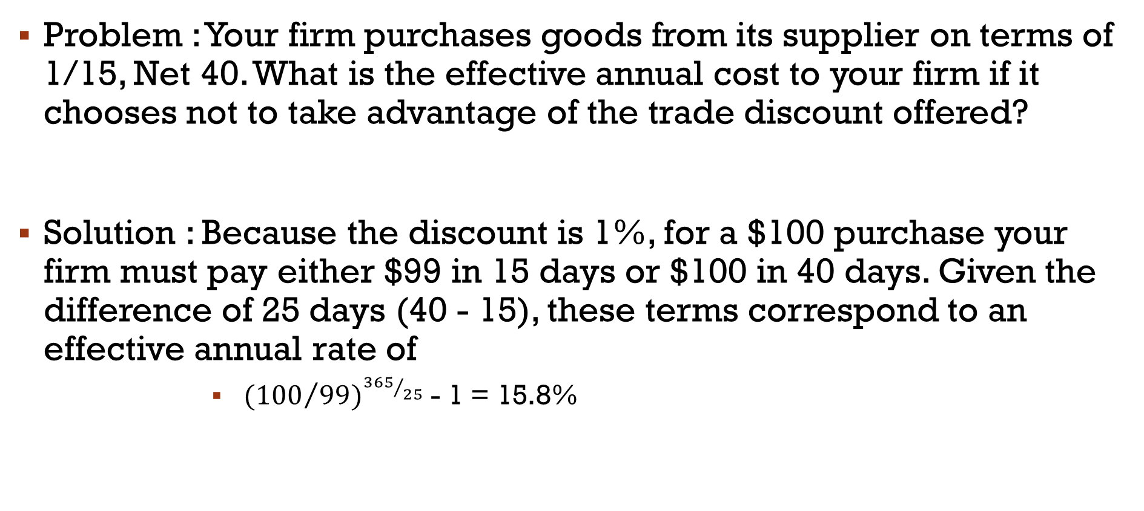
Example 26.2 Estimating the Effective Cost of Trade Credit
Problem : Your firm purchases goods from its supplier on terms of 1/15, Net 40. What is the effective annual cost to your firm if it chooses not to take advantage of the trade discount offered?
Solution : Because the discount is 1%, for a $100 purchase your firm must pay either $99 in 15 days or $100 in 40 days. Given the difference of 25 days (40 - 15), these terms correspond to an effective annual rate of
${({100}/{99})}^{{365}/{25}}$ - 1 = 15.8%

Slide 20
Benefits of Trade Credit
For a number of reasons, trade credit can be an attractive source of funds. First, trade credit is simple and convenient to use, and it therefore has lower transaction costs than alternative sources of funds. For example, no paperwork must be completed, as would be the case for a loan from a bank. Second, it is a flexible source of funds, and can be used as needed. Finally, it is sometimes the only source of funding available to a firm.

Slide 21
Trade Credit Versus Standard Loans
First, providing financing at below-market rates is an indirect way to lower prices for only certain customers. Consider, for example, an automobile manufacturer. Rather than lower prices on all cars, the financing division may offer specific credit terms that are attractive to customers with bad credit, but unattractive to customers with good credit. In this way, the car manufacturer is able to discount the price only for those customers with bad credit who otherwise might not be able to afford the car.

Slide 22
Trade Credit Versus Standard Loans
Second, because a supplier may have an ongoing business relationship with its customer, it may have more information about the credit quality of the customer than a traditional outside lender such as a bank. The supplier may also be able to increase the likelihood of payment by threatening to cut off future supplies if payment is not made. Finally, if the buyer defaults, the supplier may be able to seize the inventory as collateral.

Slide 23
Managing Float
One factor that contributes to the length of a firm’s receivables and payables is the delay between the time a bill is paid and the cash is actually received. This delay, or processing float, will impact a firm’s working capital requirements.
Collection Float
Disbursement Float
Electronic Check Processing

Slide 24
Collection Float
Collection float is the amount of time it takes for a firm to be able to use funds after a customer has paid for its goods. Firms can reduce their working capital needs by reducing their collection float.
Mail float: How long it takes the firm to receive the check after the customer has mailed it
Processing float: How long it takes the firm to process the check and deposit it in the bank
Availability float: How long it takes before the bank gives the firm credit for the funds

Slide 25
Disbursement Float
Disbursement float is the amount of time it takes before payments to suppliers actually result in a cash outflow for the firm. Like collection float, it is a function of mail time, processing time, and check-clearing time. Although a firm may try to extend its disbursement float in order to lengthen its payables and reduce its working capital needs, it risks making late payments to suppliers.
In some cases, the supplier may refuse to do business in the future with the delinquent firm.

Slide 26
Electronic Check Processing
Firms can employ several methods to reduce their collection and disbursement floats.
The Check Clearing for the 21st Century Act (Check 21), which became effective on October 28, 2004, eliminated the disbursement float due to the check-clearing process. Under the Act, banks can process check information electronically, and the funds are deducted from a firm’s checking account on the same day that the firm’s supplier deposits the check in its bank in most cases.
There are, however, several ways that a firm can reduce its collection float.

Slide 27
26.3
Receivable Management
Determining the Credit Policy
Monitoring Accounts Receivable
Notes:
26.3 應收帳款管理
剛剛討論了一般交易上的成本跟收益，接著我們要來看一些由公司應收帳款管理比較特別的議題，這裡專注一家公司如何採用提供客戶信貸的政策，以及如何持續監控其應收賬款。

Slide 28

dETERMINING THE CREDIT POLICY
Establishing Credit Standards
Establishing Credit Terms
Establishing a Collection Policy
Monitoring Accounts Receivable
Accounts Receivable Days
Aging Schedule
Notes:
決定信貸政策 ( Determining the Credit Policy )
建立信貸政策的三個步驟，我們將依次討論：
1.建立信用標準 ( Establishing Credit Standards )
2.建立信用條款 ( Establishing credit terms )
3.建立收款政策 ( Establishing a collection policy)
監督應收帳款 ( Monitoring Accounts Receivable)
建立信貸政策後，公司必須監督其應收帳款去進行分析這個信貸政策是否有效運作。
企業用來監控產品和服務的兩種工具應收帳款是應收賬款天數（或平均收款期）和 帳齡表。

Slide 29
Establishing Credit Standards
Management must first decide on its credit standards
Assess the credit risk of each customer before deciding whether to grant credit.
The decision of how much credit risk to assume plays a large role in determining how much money a firm ties up in its receivables.
Notes:
建立信用標準
管理層必須先決定公司的信用標準。
將信用擴展到任何申請它的人嗎？(每個人都可以申請嗎？(來者不拒))
選擇性的 僅向信用風險極低的客戶提供信貸？
-> 通常需要先評估每個客戶的信用風險 決定是否授予信用。
除非公司 採取以前的政策，不然需要先評估每個客戶的信用風險 決定是否授予信用。
大公司通常會在自己的信貸部門進行分析，許多小公司則是從信用評級機構，購買信用報告。
3. 承擔多少信用風險的決定，對於公司應收賬款佔用多少資金方面非常重要。
-> 公司承擔的信用風險越高，應收帳款就會增加，但是公司也要衡量他所能承擔的風險
(如果客戶應收帳款增加)
雖然限制性政策可能導致銷量下降，但該公司在應收賬款上的投資會減少。相反，選擇性較低政策將產生更高的銷售額，但應收帳款水平也會上升。

Slide 30
Establishing Credit Terms
Deciding on the length of the period before payment must be made the “net” period
Choosing whether to offer a discount to encourage early payments
If it offers a discount, it must also determine the discount percentage and the discount period.
Notes:
建立信用條款
公司決定信用標準後，下一個步驟是確定信用條款。
公司決定付款前的期限必須設定（“淨”期間）-> 設定最後還款日
-> 公司決定必須付款(還款)期限並選擇是否提供折扣以鼓勵 提前付款。
如果提供折扣，則還必須確定折扣百分比和 折扣期間。
如果公司規模相對較小，則可能會跟隨這個產業的其他公司建立這些條款。
(Accounts receivable ÷ Annual revenue) x Number of days in the year = Accounts receivable days

Slide 31
Establishing a Collection Policy
Doing nothing
Sending a polite letter of inquiry
Charging interest on payments extending beyond a specified period
Threatening legal action at the first late payment
Notes:
建立收款政策
制定信貸政策的最後一步就是建立收款政策。
該政策的內容範圍很廣，
從如果客戶延遲付款（通常不是一個好的選擇）什麼都不做到發送禮貌的詢問信、對超過指定期限的付款收取利息，、威脅要在第一次逾期付款時採取法律行動。

Slide 32
Accounts Receivable Days
Accounts receivable days
＝ (Accounts receivable ÷ Annual revenue) x Number of days in the year
＝ Accounts receivable ÷ Daily sales
It is the average number of days that it takes a firm to collect on its sales.
A firm can compare this number to the payment policy specified in its credit terms to judge the effectiveness of its credit policy
Notes:
應收帳款天數 = 應收帳款 / 年營收*一年的天數 = 應收帳款/每日營收
應收帳款天數 ( Accounts Receivable Days )
應收賬款天數是公司收回其銷售所需的平均天數。
公司可以將此數字與信用條件中指定的付款政策進行比較，以判斷其信用政策的有效性。

Slide 33
Accounts Receivable Days
If the credit terms specify “Net 30” and the accounts receivable days outstanding is 50 days, the firm can conclude that its customers are paying 20 days late, on average.
The firm may want to reexamine its credit policy, if it has been increased.
Outside investors commonly use this measure to evaluate a firm’s credit management policy.
A major weakness of the accounts receivable days is that it is merely one number and conceals much useful information.
Notes:
1. 如果信用條件指定為“淨額30”，未收帳款天數為50天，公司可以得出結論，其客戶平均要延遲20天付款。
2. 公司還應查看一段時間內應收帳款的趨勢。
-> 如果在過去的幾年中，公司的應收帳款天數大約為35天，今年為43天，這家公司可能要重新檢視其信貸政策。(當然，如果經濟不景氣，整個行業可能都會受到影響。在這些情況下，增長可能與公司本身無關。)
3. 由於應收賬款天數可以從公司的財務報表中計算得出，外部投資者通常使用這種方法來評估公司的信貸管理政策。
4. 應收賬款天數的主要缺點在於，它僅僅是一個數字因此隱藏了很多有用的訊息。
（季節性銷售模式可能會導致應收賬款天數的計算數字發生變化，具體取決於計算時間，即使該公司很大一部分客戶遲交，這個數字看起來很合理。）

Slide 34
Aging Schedule
Aging schedule categorizes accounts by the number of days they have been on the firm’s books
It can be prepared using either the number of accounts or the dollar amount of the accounts receivable outstanding.
Notes:
帳齡表是指反映應收帳款的時間，以及不同時間下的應收帳款所占應收帳款總額百分比的一種表格。
它可以部分程度地將銷售動態與客戶付款動態區別開來，用來說明應收帳款存在的時間長度。
主要統計應收帳款的帳戶數 以及應付帳款的美元金額。

Slide 35
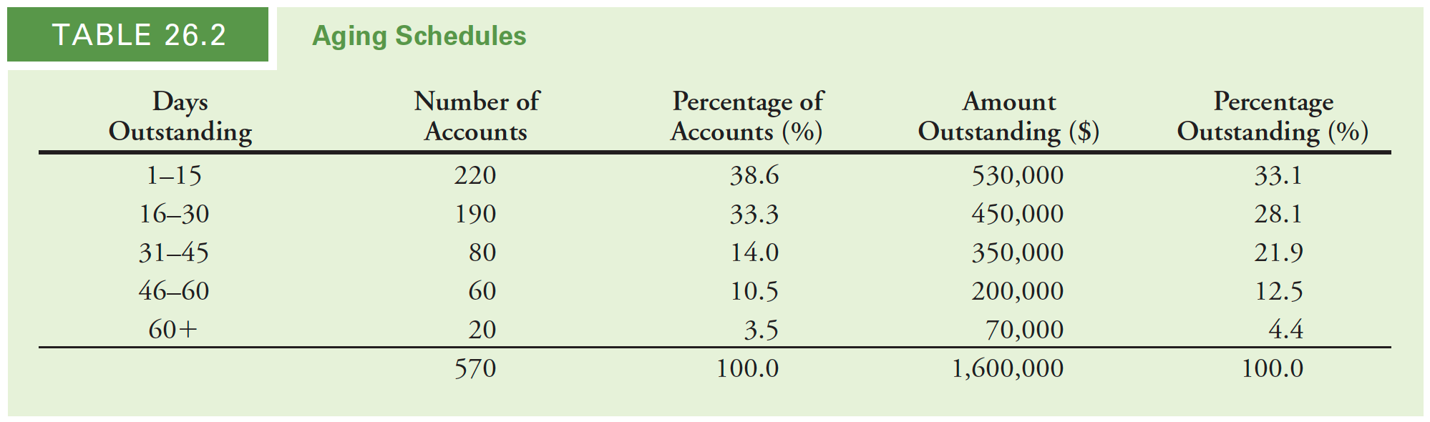
Aging Schedule
For example, assume that a firm selling on terms of 2/15, Net 30, has $530,000 in accounts receivable that has been on the books for 15 or fewer days in 220 accounts. Another $450,000 has been on the books for 16 to 30 days and is made up of 190 accounts, and $350,000 has been on the books for 31 to 45 days and represents 80 accounts. The firm has $200,000 that has been on the books for 46 to 60 days in 60 accounts. Yet another $70,000 has been on the books for more than 60 days and is made up of 20 accounts.
Notes:
假設一個公司以(15天內付清享有2%的(現金)折扣，淨額30 (最晚30天內要付清) 如果超過30天就是壞帳，
53萬美元的應收帳款已記入可在220個帳戶中預訂15天或更少的天數
45萬美元已記入16到30天，由190個帳戶組成
35萬美元的賬面餘額為31至45天，代表80個帳戶。
該公司20萬美元已記入賬目60個帳戶中的46至60天。
賬上還有另外7萬美元，60天，由20個帳戶組成。
表26.2包括了基於帳戶數和未付清金額。

Slide 36
Aging Schedule
In this case, if the firm’s average daily sales is $65,000, its accounts receivable days is $1,600,000/$65,000 = 25 days. But on closer examination, using the aging schedules in Table 26.2, we can see that 28% of the firm’s credit customers and 39% by dollar amounts are paying late.
28%
39%
Notes:
在這種情況下，如果公司的平均每日銷售額為$ 65,000，則其應收帳款天數為160萬美元 / 6萬5美元 ＝ 25天(可以估計大概多久會收回這些應收帳款)。但是仔細觀察一下，使用表26.2中的賬齡表，我們可以看到該公司28％的信貸客戶沒有按時還款，以美元金額計算的話，佔了39％沒有按時還款 (壞帳)。
延遲付款

Slide 37
Aging Schedule
If the percentages in the lower half of the schedule begin to increase—the firm will likely need to revisit its credit policy.
Aging schedule is also sometimes augmented by analysis of the payments pattern, which provides information on the percentage of monthly sales that the firm collects in each month after the sale.
Notes:
1. 指如果下半部分的百分比時間表開始增加-公司可能需要重新審視其信貸政策
2. 帳齡表有時還可以透過分析付款模式來提供有關公司每月售後收取的月銷售額百分比的信息。
百分比減少比較正常

Slide 38
26.4
Payables Management
Determining Accounts Payable Days Outstanding
Stretching Accounts Payable
Notes:
26.4 應付帳款管理
只有在貿易信貸最便宜的情況下，企業才應選擇使用應付賬款進行借貸資金來源。貿易信貸的成本取決於信貸條款。越高提供的折扣百分比，放棄折扣的成本越高。放棄的代價如果貸款期限較短，則折扣也更高。當公司有選擇權時，在來自兩個不同供應商的貿易信貸之間，應該採用價格較低的替代方案。

Slide 39
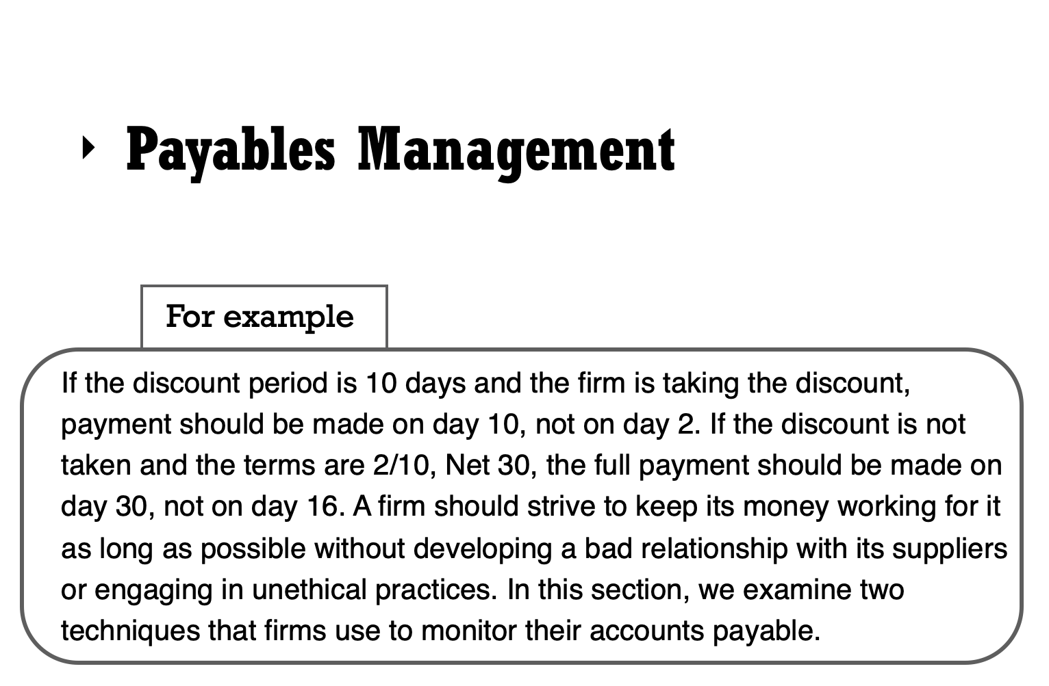

Slide 40
Determining Accounts Payable Days Outstanding
Similar to the situation with its accounts receivable
Calculate the accounts payable days outstanding and compare it to the credit terms
The accounts payable days outstanding is the accounts payable balance expressed in terms of the number of days of cost of goods sold.
Notes:
決定應付帳款天數
1. 與應收賬款情況類似，公司應監控其應付款，以確保其在最佳時間付款。
2. 計算未付應付帳款天數，並將其與信貸條款進行比較。
3. 應付賬款天數是以應付賬款天數表示的應付賬款餘額銷貨成本。
如果應付賬款天數為40天，期限為2/10（淨額30），則該公司可以得出結論，它一般會延遲付款，並可能冒著供應商困難的風險。相反，如果應付帳款天數為25天，而該公司未採用折扣，這家公司為時過早。它可能會再賺五天的利息。

Slide 41
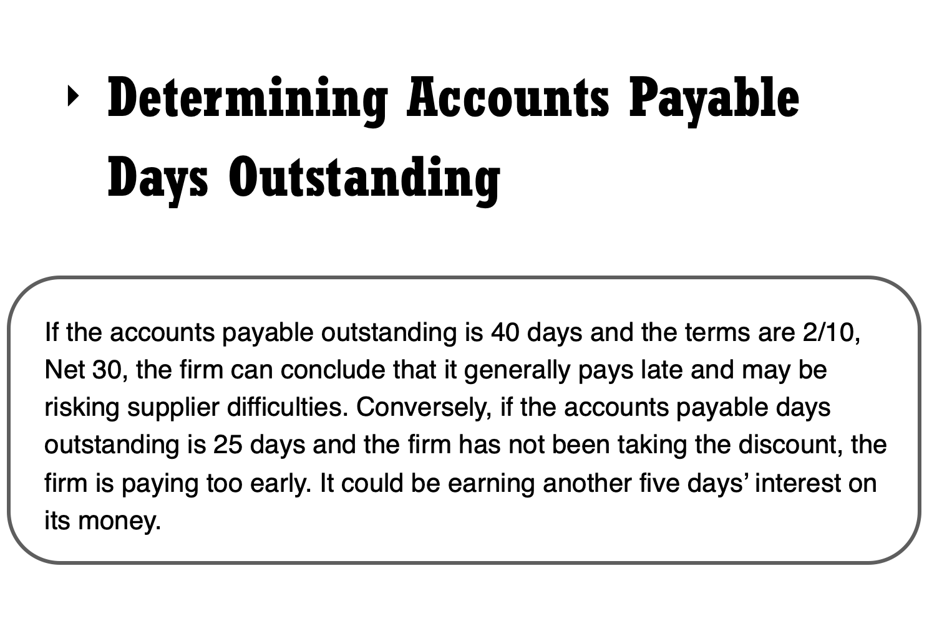

Slide 42
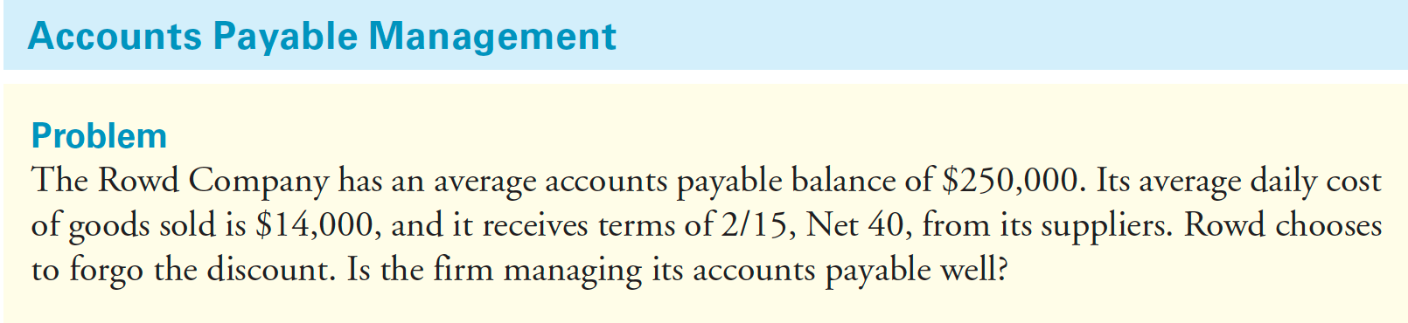
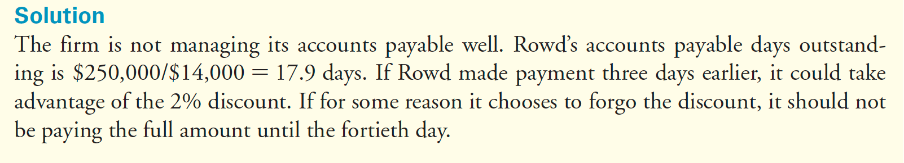
Determining Accounts Payable Days Outstanding

Slide 43
Stretching Accounts Payable
Some firms ignore the payment due period and pay later, in a practice referred to as stretching the accounts payable.
For example
Given terms of 2/10, Net 30, a firm may choose to not pay until 45 days have passed. Doing so reduces the direct cost of trade credit because it lengthens the time that a firm has use of the funds. While the interest rate per period remains the same : $2 / $98 = 2.04% - the firm is now using the $98 for 35 days beyond the discount period, rather than 20 days as provided by the trade credit terms.
Notes:
一些公司忽略了到期付款期限，而是在以後付款，這種做法稱為延長應付賬款。
例如，給定條件2/10（淨值30），公司可以選擇在45天后才付款。這樣做降低了直接貿易成本信用，因為它延長了公司使用資金的時間。雖然興趣每個期間的費率保持不變：$ 2 / $ 98 = 2.04％：公司現在將$ 98用於優惠期後35天，而不是貿易信用證規定的20天條款。

Slide 44
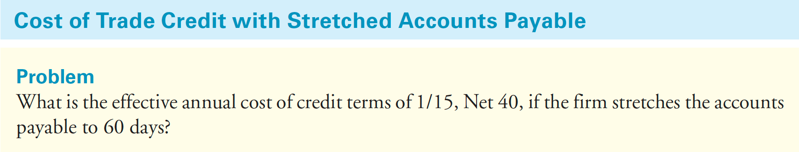
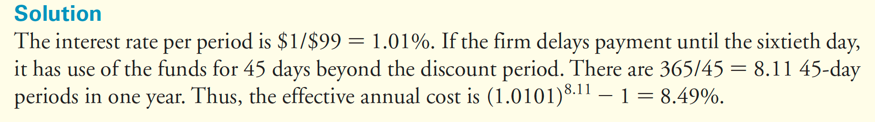
Stretching Accounts Payable
Notes:
企業也可以在第三十天付款，但只支付折扣價。
有些人可能只支付折扣價，甚至要在第30天才支付。儘管所有這些措施都會降低與貿易信貸相關的有效年利率，但企業可能會因這些措施而產生成本。
供應商可以對以下企業做出反應：
付款時總是採用貨到付款（COD）或交付（CBD）。
拖欠的公司則承擔與這些相關的額外費用條款，並且可能需要協商銀行貸款以支付現金。
供應商還可能終止與違約客戶的業務，從而使客戶尋找其他來源，可能價格更高或質量較低。信用等級差可能還會導致結果，使公司很難與其他任何供應商取得良好的合作關係。此外，當公司明確同意銷售條款時，將違反這些條款在大多數人的腦海中構成不道德的商業行為。
note :
未付天數（DPO）是指公司償還應付賬款的平均天數。
因此，未付應付天數衡量了公司對應付賬款的管理水平。
DPO為20意味著公司平均需要20天才能償還其供應商。

Slide 45
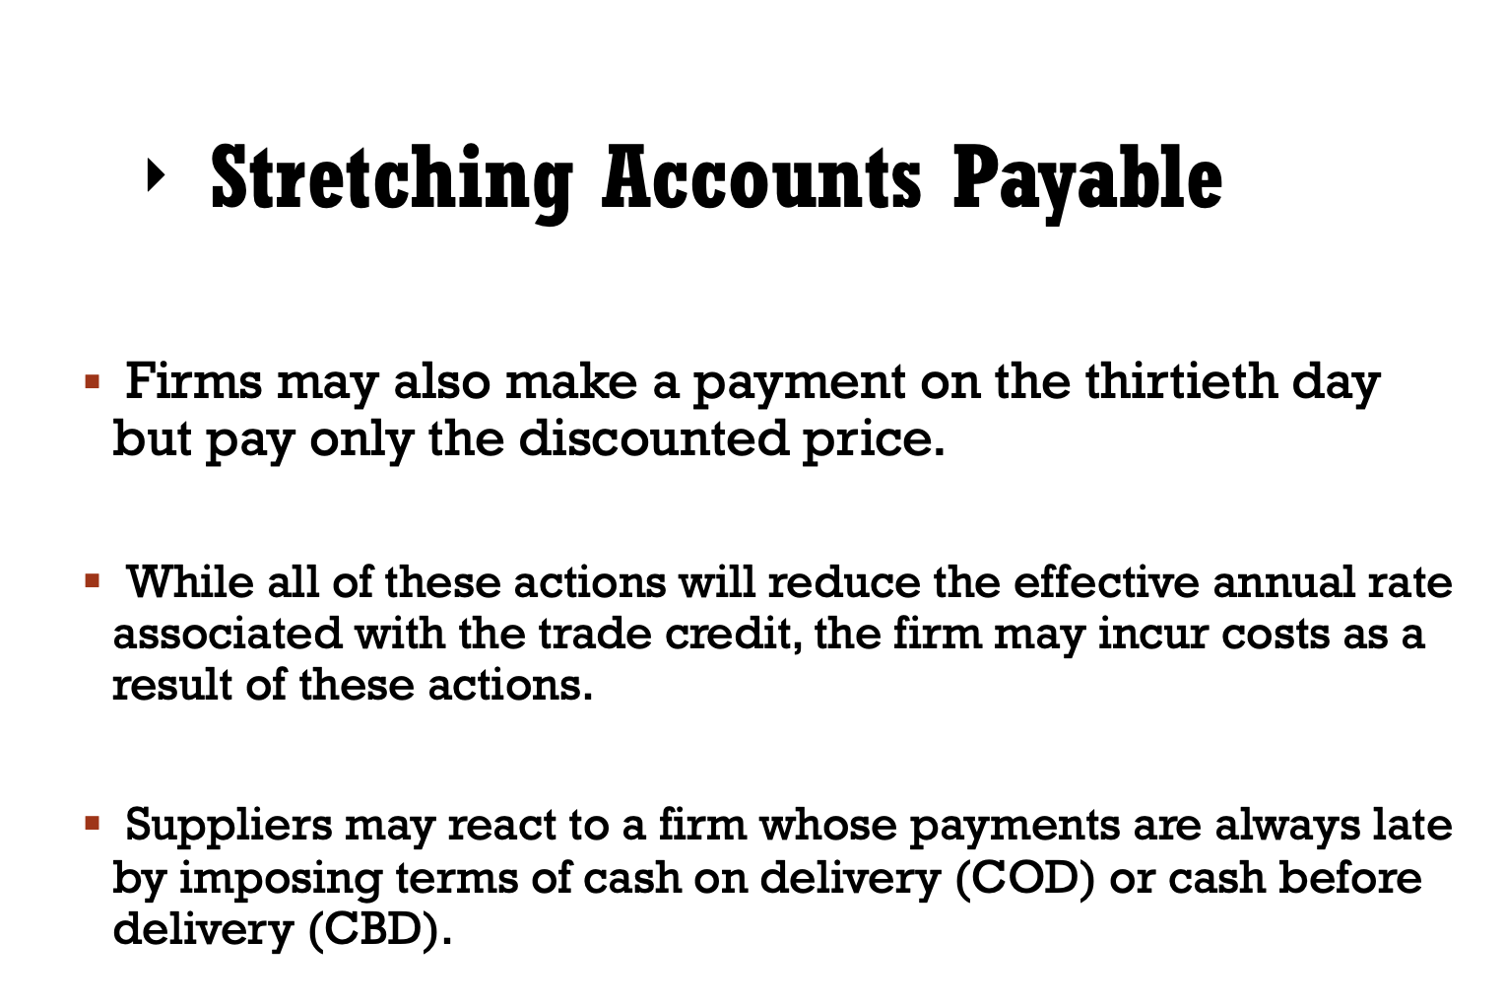

Slide 46
26.5
Inventory Management
Benefits of Holding Inventory
Costs of Holding Inventory
Notes:
接下來要討論到的是「存貨管理」
其中會講到「持有存貨的好處」和「持有存貨所需花費的成本」

Slide 47

Inventory Management 存貨管理
In a perfect markets setting, firms would not need payables or receivables.
Interest rates on trade credit would be competitive, and firms could use alternative sources of financing.
Unlike trade credit, inventory represents one of the required factors of production.
Even in a perfect markets setting in which the Modigliani-Miller propositions hold, firms still need inventory.
Notes:
正如剛剛所討論到的，
在理想的市場環境中，公司可以不需要應收帳款和應付帳款。
只要信用交易(貿易信貸)具有競爭力，企業可以使用其他的資金來源。
但是，存貨與信用交易(貿易信貸)不同，存貨是生產的必需要素之一。
因此，即使是在理想市場環境中，公司仍然需要存貨。

Slide 48
Inventory Management 存貨管理
Financial manager
Must arrange for the financing necessary to support the firm’s inventory policy.
Responsible for ensuring the firm’s overall profitability.
Inventory manager
To balance the costs and benefits associated with inventory.
Notes:
有效的存貨管理可以提高公司價值。
那公司要如何做好存貨管理呢？其中一個重點是各職位的分工與合作。
財務經理有兩個工作：1. 安排必要的資金以支持公司的存貨政策 2. 負責確保公司的整體盈利能力
而存貨經理的責任是管控與存貨相關的成本和收益

Slide 49

Benefits of Holding Inventory
A firm needs its inventory to operate for several reasons.
If a firm holds too little inventory, stock-outs, the situation when a firm runs out of goods, may occur, leading to lost sales. Disappointed customers may switch to one of the firm’s competitors.
Firms may hold inventory because factors such as seasonality in demand mean that customer purchases do not perfectly match the most efficient production cycle.
Notes:
【持有存貨的好處】
公司運作之所以需要存貨有幾個重要的原因：
首先，如果一家公司的存貨太少，就會出現缺貨的情況，這可能會導致公司的商品耗盡，進一步造成銷售損失。
而客戶買不到商品會對公司感到失望，從而去買別家競爭公司的商品。所以說，存貨可以降低公司發生缺貨的風險。
再來，公司會需要存貨的原因還有季節性因素，客戶對於商品的需求可能因為淡季或旺季而有所不同，意味著客戶的購買需求不能完全符合最有效的生產週期。

Slide 50


The case of the Sandpoint Toy Company
Toy Company → Holiday Gift Season
Inventory would not accumulate, freeing up cash flow from working capital and reducing the costs of inventory.
Seasonal manufacturing incurs additional costs.
The optimal choice is likely to involve a compromise between the two extremes.
Notes:
關於這二點，課本有提到一個美國玩具公司的例子：
美國玩具公司其實都有一個特點是他們八成的年銷售額會集中在9月至12月之間，因為這些月份有很多特別節日會需要送禮物，
所以玩具的銷售量會大增，那因為這個現象，公司可能會考慮採用季節性的生產策略，
在銷售旺盛的9月至12月之間生產較多的玩具。這做法可以降低存貨成本，從而釋放流動資金中的現金流。
但是，季節性生產也會產生額外的成本，例如：在旺季所造成的製造設備磨損，以及需要雇用和培訓更多的臨時工。
所以公司必須衡量存貨積累的成本和有效生產收益之間的關係。最佳的選擇往往會在兩個方法之間去取折衷。

Slide 51

Costs of Holding Inventory 存貨成本
We can classify the direct costs associated with inventory into three categories:
Acquisition costs are the costs of the inventory itself over the period being analyzed (usually one year).
Order costs are the total costs of placing an order over the period being analyzed.
Carrying costs include storage costs, insurance, taxes, spoilage, obsolescence, and the opportunity cost of the funds tied up in the inventory.
Notes:
囤積存貨對一家公司來說是需要成本的。
我們可以將與存貨相關的成本分為三類：
1.「取得成本」存貨本身的成本（計算期間通常為一年）。
2.「訂購成本」在期間內下訂單的總成本。
3.「儲存成本」包括倉儲成本（租金、水電費、保險、稅金、損壞、報廢），和囤積存貨所需花費的機會成本。

Slide 52
Costs of Holding Inventory 存貨成本
Minimizing these total costs involves some trade-offs.
If we assume no quantity discounts are available, the lower the level of inventory a firm carries, the lower its carrying cost, but the higher its annual order costs, because it needs to place more orders during the year.
The benefits from reducing inventory requirements can be substantial.
Notes:
如果我們要將這些成本縮減到最小往往會需要做一些取捨。
例如，假設公司購買存貨沒有數量上的優惠折扣，那麼公司囤積存貨的數量就會越低，雖然存貨成本也就越低，
但是公司的年度訂單成本就越高，因為它需要在一年當中下很多次的訂單。

Slide 53
benefits OF reducing inventory
The benefits from reducing inventory requirements can be substantial.
In 2003, the apparel chain GAP reduced its investment in inventory significantly by reducing its inventory days outstanding by 24%. This change freed up $344 million for other purposes.
GAP invested some of this cash in short-term securities—primarily in U.S. government and agency securities and in bank certificates of deposits with maturities between three months and one year.
The firm reported an increase of $1.2 million in interest income in fiscal year 2003 compared with fiscal year 2002. It attributed the increase to increases in the average cash balances available for investment.
Notes:
其實縮減存貨需求可以帶來很大的好處，像這邊課本有舉一個例子。
在2003年，服裝連鎖店GAP實施將「庫存周轉天數」縮減了24%，大幅減少存貨成本。
這個變更更是釋放了3.44億美元用於其他用途，GAP就將部分資金用於投資短期證券（主要是政府債券和機構證券），以及銀行的定期存款（期限在三個月至一年）。
該公司的財政報告也說明了，與2002年相比，2003年的財政利息收入增加了120萬美元。這都要歸功於可用於投資的平均現金餘額增加。

Slide 54
just-in-time
Some firms seek to reduce their carrying costs as much as possible.
With “just-in-time” (JIT) inventory management, a firm acquires inventory precisely when needed so that its inventory balance is always zero, or very close to it.
This technique requires exceptional coordination with suppliers as well as a predictable demand for the firm’s products.
There may be a trickle-down effect when one firm in an industry adopts JIT.
Notes:
為了能夠盡可能地降低儲存成本，有一些公司會去運用 “just-in-time” (JIT) 存貨管理制度。
just-in-time 就是指說：公司可以在需要的時候精確地獲取存貨，因此公司存貨餘額很可能接近為零。
如果要使用這種做法需要與供應商有很好的溝通協調，並且需要對產品的需求量做好準確的預測。
另外，當產業中的一家公司採用JIT時，可能會產生「涓滴效應」trickle-down effect。
例如，在1999年，「玩具反斗城」運用了 just-in-time 制度，導致其供應商之一玩具製造商「孩之寶」改變了生產時間表。

Slide 55
26.6
Cash Management
Motivation for Holding Cash
Alternative Investments
Notes:
接下來是「現金管理」
其中又分為「持有現金的動機」和「另類投資」的部分

Slide 56

Modigliani-Miller (MM)
In the Modigliani-Miller setting, the level of cash is irrelevant.
With perfect capital markets, a firm is able to raise new money instantly at a fair rate, so it can never be short of cash.
Similarly, the firm can invest excess cash at a fair rate to earn an NPV of zero.
Notes:
在米勒定理中，企業價值不會因為企業融資方式的改變而改變。
只要憑藉完善的資本市場，公司能夠以合理的價格立即籌集到新的資金，因此公司永遠不會缺少現金。
同時，公司也可以投資合理比率的多餘現金，以得到 淨現值NPV為零。

Slide 57
THE cost OF Liquidity
Holding liquid assets may earn a below-market return, and a firm may face transaction costs if it needs to raise cash quickly.
Due to the double taxation of corporate interest income, holding excess cash has a tax disadvantage.
The optimal strategy for a firm is to hold cash in anticipation of seasonalities in its operating or investment cash flows, as well as to buffer random shocks that affect the business.
Risky firms and firms with high-growth opportunities tend to hold a relatively high percentage of assets as cash.
Firms with easy access to capital markets (for which the transaction costs of raising cash are lower) tend to hold less cash.
Notes:
我們剛剛提到的是米勒定理的假設，但在現實世界中呢？
在現實世界中，市場並不完美，市場流動性是有成本的；
1. 首先，流動資產的收益率通常低於固定資產的收益率，像是現金就無法帶來投資收益，而公司如果需要快速籌集現金的話，則可能會面臨交易成本。
2. 再來，如果對公司的利息收入進行雙重徵稅的話，持有過多現金可能會在稅收上處於不利。
在這些情況下，公司的最佳策略是在「預期公司經營或投資現金流量會出現季節性變化的情況下」持有現金，並緩衝影響業務的隨機衝擊。
而持有較高比例的現金資產的往往是風險公司或是具有高增長機會的公司。
而持有較少現金的公司往往比較容易進入資本市場（因為他們籌集現金的交易成本較低）。

Slide 58
Motivation for Holding Cash
There are three reasons why a firm holds cash:
To meet its day-to-day needs
To compensate for the uncertainty associated with its cash flows
To satisfy bank requirements
Notes:
公司持有現金的三個原因：
1. 滿足公司日常需求
2. 彌補現金流量帶來的不確定性
3. 滿足銀行要求
那接下來我們就會詳細討論到這些動機。

Slide 59
Transactions Balance 交易餘額
The amount of cash a firm needs to be able to pay its bills is sometimes referred to as a transactions balance.
The amount of cash a firm needs to satisfy the transactions balance requirement depends on both the average size of the transactions made by the firm and the firm’s cash cycle.
One common measure used to assess whether the firm has adequate liquidity to meet short-term needs is its quick ratio, which is the ratio of current assets other than inventory to current liabilities.
By increasing its cash balance, the firm can raise its quick ratio to its desired level.
Notes:
首先，如果要「滿足公司日常需求」就會討論到「交易餘額」。
就像我們人一樣，公司也必須持有足夠的現金來支付賬單。
那交易餘額也可以想成是公司支付賬單所需要用到的現金。
交易餘額所需的現金量取決於公司交易的平均規模和公司的現金周期，
公司會去預估交易餘額，以便公司的現金和其他流動證券足以支付其短期債務。
「速動比率」一種常用來評估公司的流動性是否滿足短期需求的重要方法。
通過增加現金餘額，公司可以將速動比率提高到所需水平。

Slide 60
Precautionary Balance 預防性餘額
The amount of cash a firm holds to counter the uncertainty surrounding its future cash needs is known as a precautionary balance.
The size of this balance depends on the degree of uncertainty surrounding a firm’s cash flows.
A useful measure to assess the firm’s desired precautionary balance is the volatility of its operating cash flows over different horizons.
Firms will typically choose to maintain liquid assets equal to some multiple of this volatility, in order to avoid the risk of experiencing a cash shortfall.
Notes:
第二點，為了「彌補現金流量帶來的不確定性」就要討論到「預防性餘額」。
預防性餘額：公司為了應對其未來現金需求的不確定性而持有的現金量。
餘額的大小取決於公司現金流量的不確定性程度。
不確定性越大，公司預測其交易需求的難度就越高，因此預防性餘額也必須增加。
公司可以使用不同經營時期的現金流波動性去評估所需的預防性餘額，
為了避免發生現金短缺的風險，公司通常會選擇將流動資產維持在波動性的幾倍左右。

Slide 61
Compensating Balance 補償性餘額
Bank may require to hold a compensating balance in an account at the bank as compensation for services that the bank performs.
Compensating balances are deposited in accounts that either earn no interest or pay a very low interest rate.
Bank offering individuals free checking so long as their balances do not fall below a certain level—say, $1000.
The customer has $1000 cash that he cannot use unless he is willing to pay a service charge.
The cash that a firm has tied up to meet a compensating balance requirement is unavailable for other uses.
Notes:
第三點，為了「滿足銀行要求」，就要提到「補償性餘額」。
銀行可能會要求公司在帳戶中保留補償餘額，作為對銀行執行服務的補償。補償餘額通常會存在沒有利息或利率很低的帳戶中。
這種方式類似是銀行提供免費支票給個人，前提是他們的餘額不可低於特定水平（例如1000美元）。
基本上，除非客戶願意支付服務費，否則他無法使用那1000美元。同樣的道理，公司放在補償餘額帳戶中的現金也無法用於其他用途。

Slide 62

Alternative Investments 另類投資（替代投資）
The firm may choose from a variety of short-term securities that differ somewhat with regard to their default risk and liquidity risk.
The greater the risk, the higher the expected return on the investment.
The financial manager must decide how much risk she is willing to accept in return for a higher yield.
If her firm expects to need the funds within the next 30 days, the manager will probably avoid the less liquid options.
Notes:
接下來要講到的是「另類投資」
另類投資，依歐盟定義，包括不動產基金、對沖基金、商品基金及基礎建設基金等，
美國一般稱為「替代投資」或「非主流投資」，具有非公開、非傳統、流動性低等特性。
我們剛剛有提到GAP公司是把現金投資在短期證券上。
但事實上，公司也可以選擇其他不同風險的短期證券。風險越大，預期的投資收益就越高。
公司的財務經理必須決定她願意接受多少的風險以換取更高的報酬。
如果公司希望在未來30天內獲得資金，公司管理者可能會去選擇風險較高但獲利也可能更高的投資商品。

Slide 63
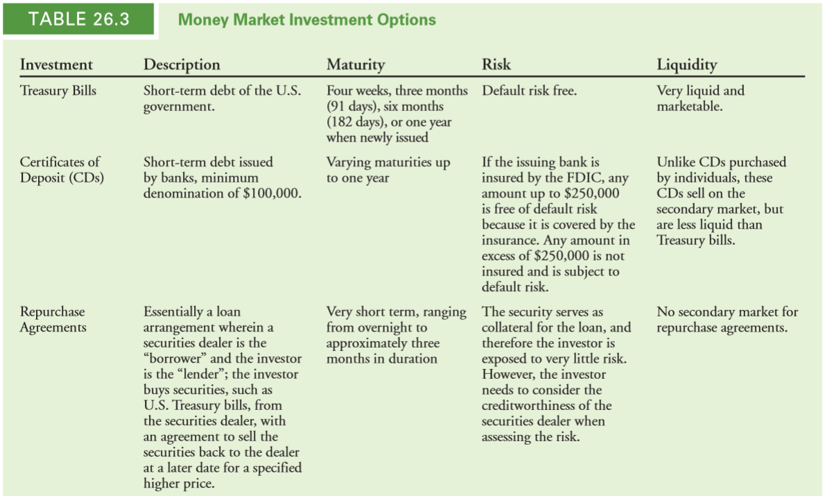
Money Market Investment Options 貨幣市場投資選擇
國庫券
定存單
附買回
交易
Notes:
表26.3 簡要描述了最常用的短期投資，這些短期債務證券統稱為貨幣市場證券。
1. 國庫券 美國政府的短期債務 沒有違約風險 流動性很強
2. 定存單 (簡稱CD) 銀行發行的短期債券 到期期限最長為一年 流動性低於國庫券。
3. 附買回交易：本質上是一種非常短期的貸款，其中證券商是“借款人”，投資者是“貸方”；投資者從證券商購買證券，並同意在之後的日期以指定較高的價格將證券賣給交易商。因為是用證券作為貸款的抵押品，所以投資者承擔的風險很小。但是，投資者在評估風險時需要考慮證券商的信譽。

Slide 64
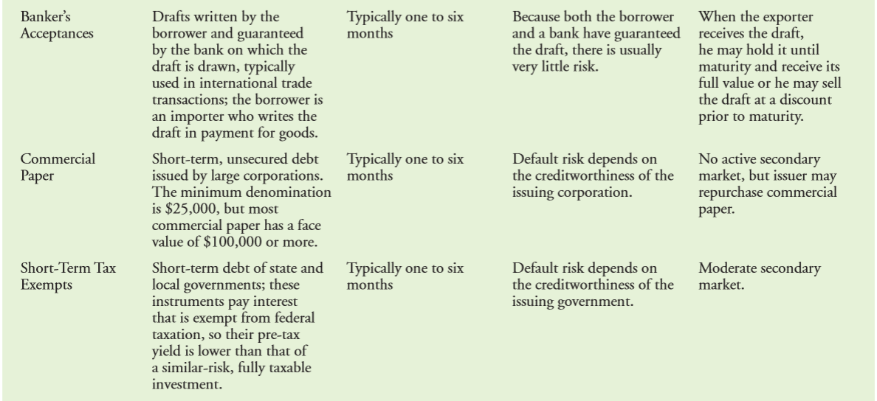
Money Market Investment Options 貨幣市場投資選擇
銀行承兌匯票
商業票據
短期免稅
Notes:
4. 銀行承兌匯票：指商業交易行為的買方或賣方委託銀行為付款人而經銀行承兌的遠期匯票，通常用於國際貿易交易中，借款人為進口商，他寫了匯票以支付貨款。由於借款人和銀行都對匯票進行了擔保，因此通常風險很小。當出口商收到匯票後，他可以持有匯票直到期限截止日並獲得匯票的全部金額，或者可以在到期前以折扣價出售。
5. 商業票據：大公司發行的短期無抵押債務，違約風險取決於發行公司的信譽。
6. 短期免稅：地方政府的短期債務；支付的利息無需繳納聯邦稅。違約風險取決於簽發國政府的信譽。
因此，如果財務經理想要選擇投資風險最小的商品的話會選擇投資國庫券。
但是，如果財務經理希望公司在短期投資中獲得更高的報酬，則可以選擇將部分多餘的現金投資於風險更大的替代方案，例如商業票據。

Slide 65
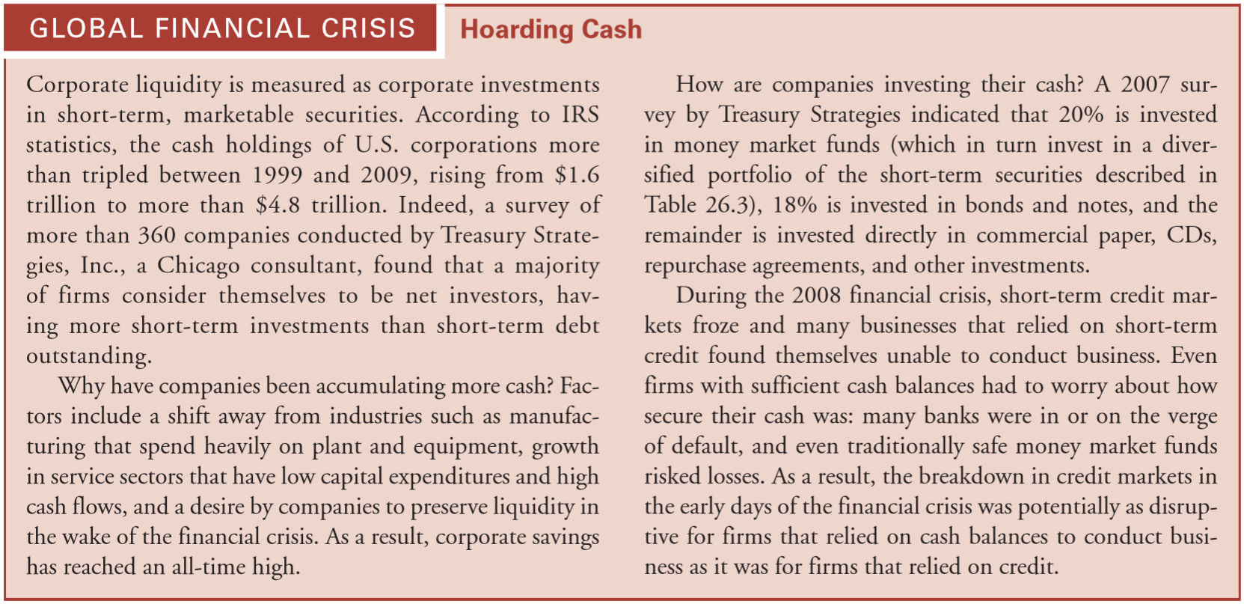
Hoarding Cash 囤積現金
According to IRS statistics, the cash holdings of U.S. corporations more than tripled between 1999 and 2009, rising from $1.6 trillion to more than $4.8 trillion.
Indeed, a survey found that a majority of firms consider themselves to be net investors, having more short-term investments than short-term debt outstanding.
Notes:
根據美國國稅局（IRS）的統計，美國公司的現金持有量在1999年至2009年期間增長了兩倍多，從1.6萬億美元增加到4.8萬億美元以上。
而實際上，調查發現大多數公司都認為自己是淨投資者，其短期投資多於未償還債務。

Slide 66
Why have companies been accumulating more cash?
Factors include a shift away from industries such as manufacturing that spend heavily on plant and equipment, growth in service sectors that have low capital expenditures and high cash flows, and a desire by companies to preserve liquidity in the wake of the financial crisis. As a result, corporate savings has reached an all-time high.
Notes:
為什麼公司要積累更多的現金？
這些因素包括製造業的行業轉移，這些行業在工廠和設備上花費大量資金，
低資本支出和高現金流量的服務行業的增長，以及公司在金融危機後保持流動性。使得公司的儲蓄達到了歷史最高水平。

Slide 67
How are companies investing their cash?
A 2007 survey by Treasury Strategies indicated that 20% is invested in money market funds, 18% is invested in bonds and notes, and the remainder is invested directly in commercial paper, CDs, repurchase agreements, and other investments.
During the 2008 financial crisis, short-term credit markets froze and many businesses that relied on short-term credit found themselves unable to conduct business. Even firms with sufficient cash balances had to worry about how secure their cash was: many banks were in or on the verge of default, and even traditionally safe money market funds risked losses.
As a result, the breakdown in credit markets in the early days of the financial crisis was potentially as disruptive for firms that relied on cash balances to conduct business as it was for firms that relied on credit.
Notes:
公司如何投資現金？
一項調查顯示，有20％的資金投資於貨幣市場基金，18％的資金投資於債券和票據，其餘直接投資於商業票據、定存單和其他投資。
在2008年金融海嘯期間，短期信貸市場陷入僵局，許多依賴短期信貸的企業發現自己無法開展業務。
即使是擁有足夠現金餘額的公司也必須擔心其現金的安全性：許多銀行都處於接近違約的邊緣，甚至傳統上的貨幣基金也有遭受損失的風險。
金融海嘯造成信貸市場的崩潰，也對於依賴信貸的公司造成破壞性影響。

Slide 68
Thanks for listening
Q & A

